Slide 1
Tabu Search for Portfolio Optimization Topic 5: Extension of Local Search
Yi-Ping Tseng
Uni: yt2690

Slide 2
Agenda
Introduction to Tabu Search
meta heuristic algorithm
TS strategy
TS memory
stopping criteria
Simple Example of TS
applying TS on TSP problem
advantages and disadvantages
Portfolio Optimization
dataset
constraints
formulation
Experiment Results
TS result
grid search on parameters
comparison with S&P 500 index and Gurobi performance

Slide 3
Introduction to Tabu Search

Slide 4
Meta Heuristic Algorithm
Wiki Definition:
a metaheuristic is a higher-level searching algorithm to provide a sufficiently good solution to an optimization problem, especially with incomplete or imperfect information or limited computation capacity.
Property:
Metaheuristics are strategies that guide the search process.
The goal is to efficiently explore the search space in order to find near–optimal solutions.
Metaheuristic algorithms are approximate and usually non-deterministic.
Notes:
It requires some stopping criteria
It can find a solution that is good enough, but the result is not guaranteed
it means you may get different solution in different search

Slide 5
Tabu Search
Tabu list: a tabu list records forbidden moves, which are referred as tabu moves.
Memory: a fixed tabu list size can prevent the algorithm from returning the same solution
Neighborhood set: a neighborhood is constructed to identify the adjacent solutions that can be reached from the current solution.
Stopping criteria: the algorithm will stop, when any criteria are matched: maximum iteration times, when there are no feasible neighbors, or early stop for no improvement in the latest n steps
Notes:
Tabu list is a set of solution which are not allowed to be used anymore
It uses a flexible memory structure to prevent the algorithm from returning the same solution
Neighbors are the feasible solution that can be reached from the current solution. The neighborhood set provides the next possible solution in each step
Because it is a searching process, the stopping criteria provides conditions to stop.
Tabu search stops when it reaches the maximum iteration times or when there are no feasible neighbors or when no improvement in the last n steps

Slide 6
Tabu Search Strategies
Forbidding strategy: the path from the current solution to the next solution will be added to the tabu list
Freeing strategy: the size of the tabu list (memory) will decide how long the element stays in it
Short-term strategy: aspiration criteria provides exception to tabu restrictions. When a tabu move has an attracitve evaluation where it would result in a solution better than any visited so far, then its tabu classification may be overridden.
Notes:
Forbidding strategy: controls what enters the tabu list
-> it can prevent from returning the previous solution
Freeing strategy: controls what exits from the tabu list
Short-term strategy: manages interplay between the forbidding and freeing stratgy to select trial solutions

Slide 7
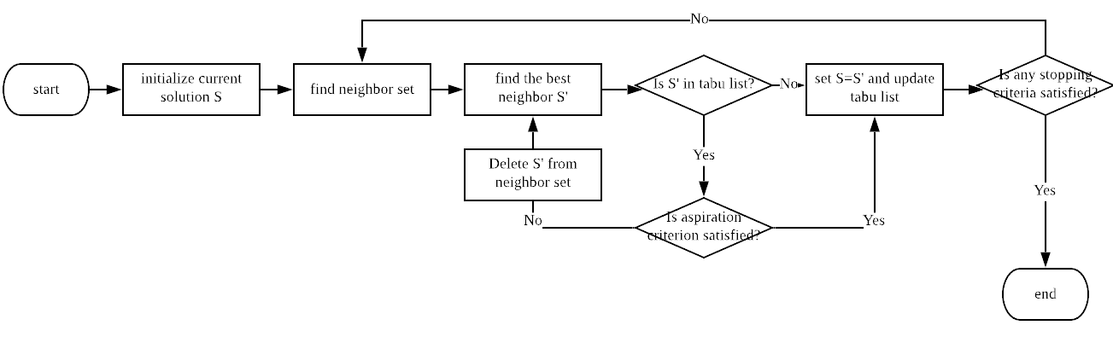
Tabu Search Algorithm
Notes:
Randomly select a feasible solution as an initial solution
Generate a neighborhood set based on the initial solution
Find the best neighbor solution in the neighborhood set
And the algorithm checks whether the best neighbor solution is in the tabu list or not
If the best neighbor solution is not in the tabu list, set the best neighbor solution as current solution
If the best neighbor solution is in the tabu list, then check whether the aspiration criteria are satisifed, if not satisfied remove it from the neighborhood set
If aspiration criteria are satisfied, then we accept it.
It iterates until one of the stopping criteria are satisifed

Slide 8
Advantages and Disadvantages
Advantages:
Can escape from a local optimum by accepting non-improving solution
Can be applied to both discrete and continuous solution spaces
Very flexible, it is a practical alternative in complex problem
The result often approximates the global optimum
Disadvantages:
Too many parameters
Optimality (converagence) is not guaranteed
Different searches may yield different solutions to the same problem

Slide 9
Example – Travlling Salesman Problem

Slide 10
TSP problem
5 cities (complete graph)– A, B, C, D, E
Objective: find the minimum distance to travel all cities and return to the starting point
S: current solution, S_best: best solution
Tabu list size = 2
Stopping criteria: iteration times = 5
Aspiration criterion: when the tabu move is better at least 1-unit distance than the current solution, we accept it.

Slide 11
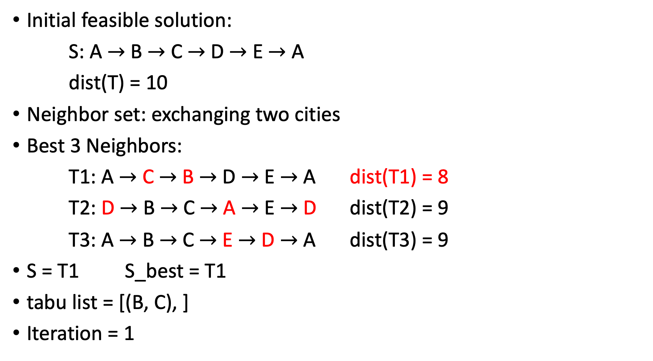
Initial feasible solution:
S: A $→$ B $→$ C $→$ D $→$ E $→$ A
dist(T) = 10
Neighbor set: exchanging two cities
Best 3 Neighbors:
T1: A $→$ C $→$ B $→$ D $→$ E $→$ A dist(T1) = 8
T2: D $→$ B $→$ C $→$ A $→$ E $→$ D dist(T2) = 9
T3: A $→$ B $→$ C $→$ E $→$ D $→$ A dist(T3) = 9
S = T1 S_best = T1
tabu list = [(B, C), ]
Iteration = 1

Slide 12
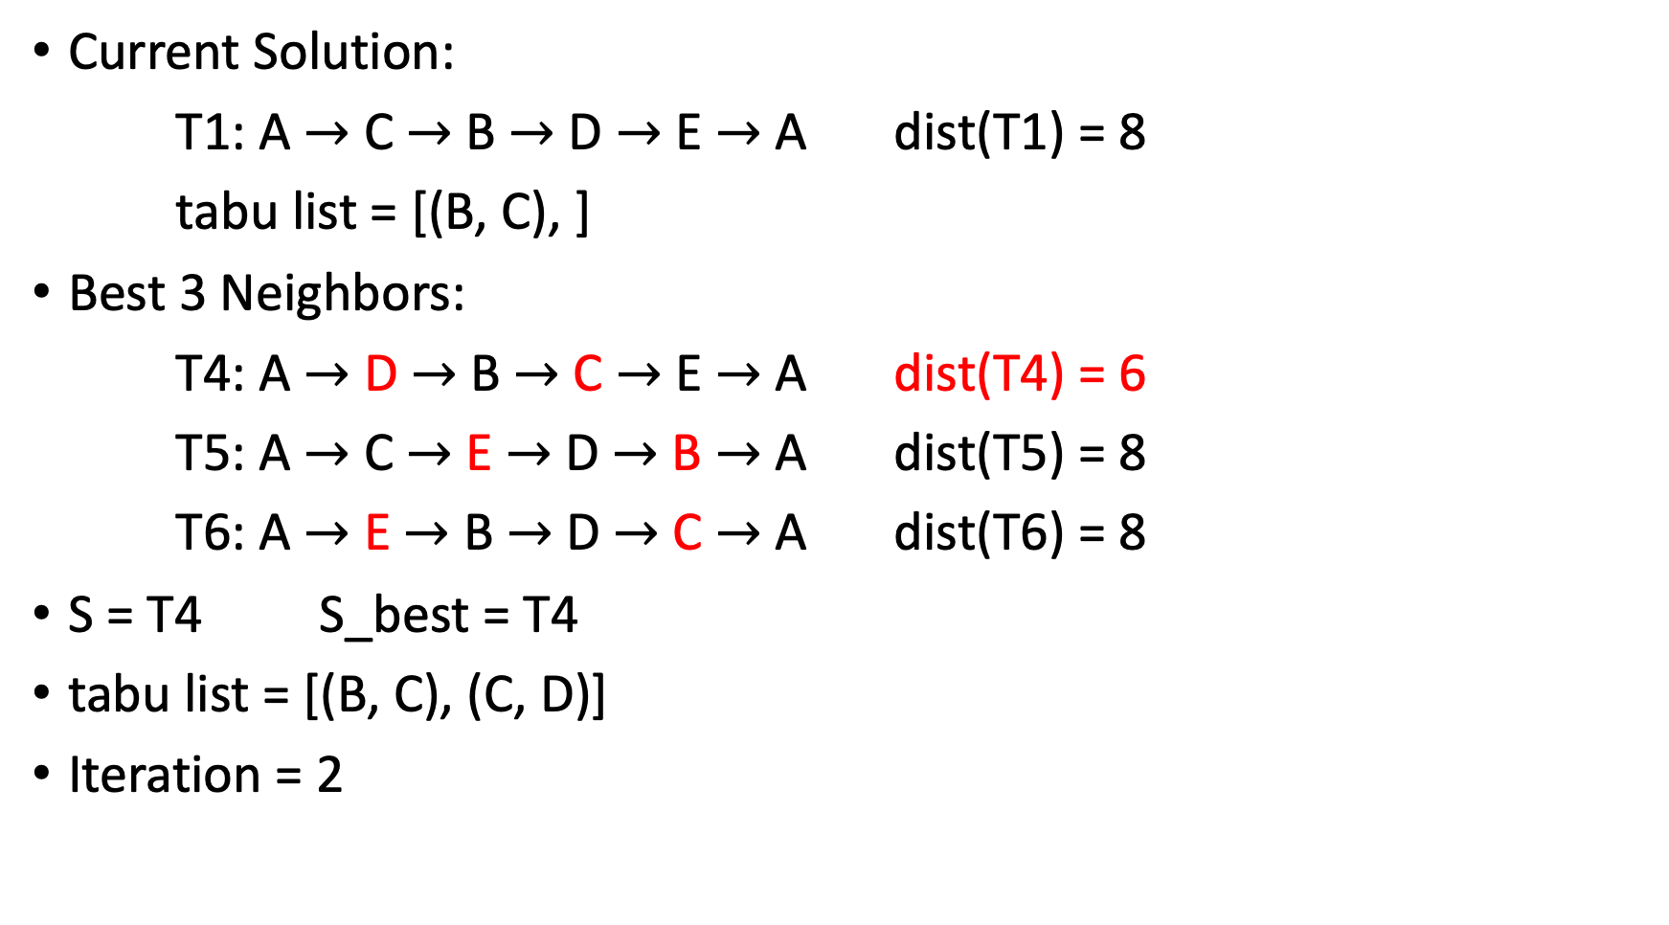
Current Solution:
T1: A $→$ C $→$ B $→$ D $→$ E $→$ A dist(T1) = 8
tabu list = [(B, C), ]
Best 3 Neighbors:
T4: A $→$ D $→$ B $→$ C $→$ E $→$ A dist(T4) = 6
T5: A $→$ C $→$ E $→$ D $→$ B $→$ A dist(T5) = 8
T6: A $→$ E $→$ B $→$ D $→$ C $→$ A dist(T6) = 8
S = T4 S_best = T4
tabu list = [(B, C), (C, D)]
Iteration = 2

Slide 13
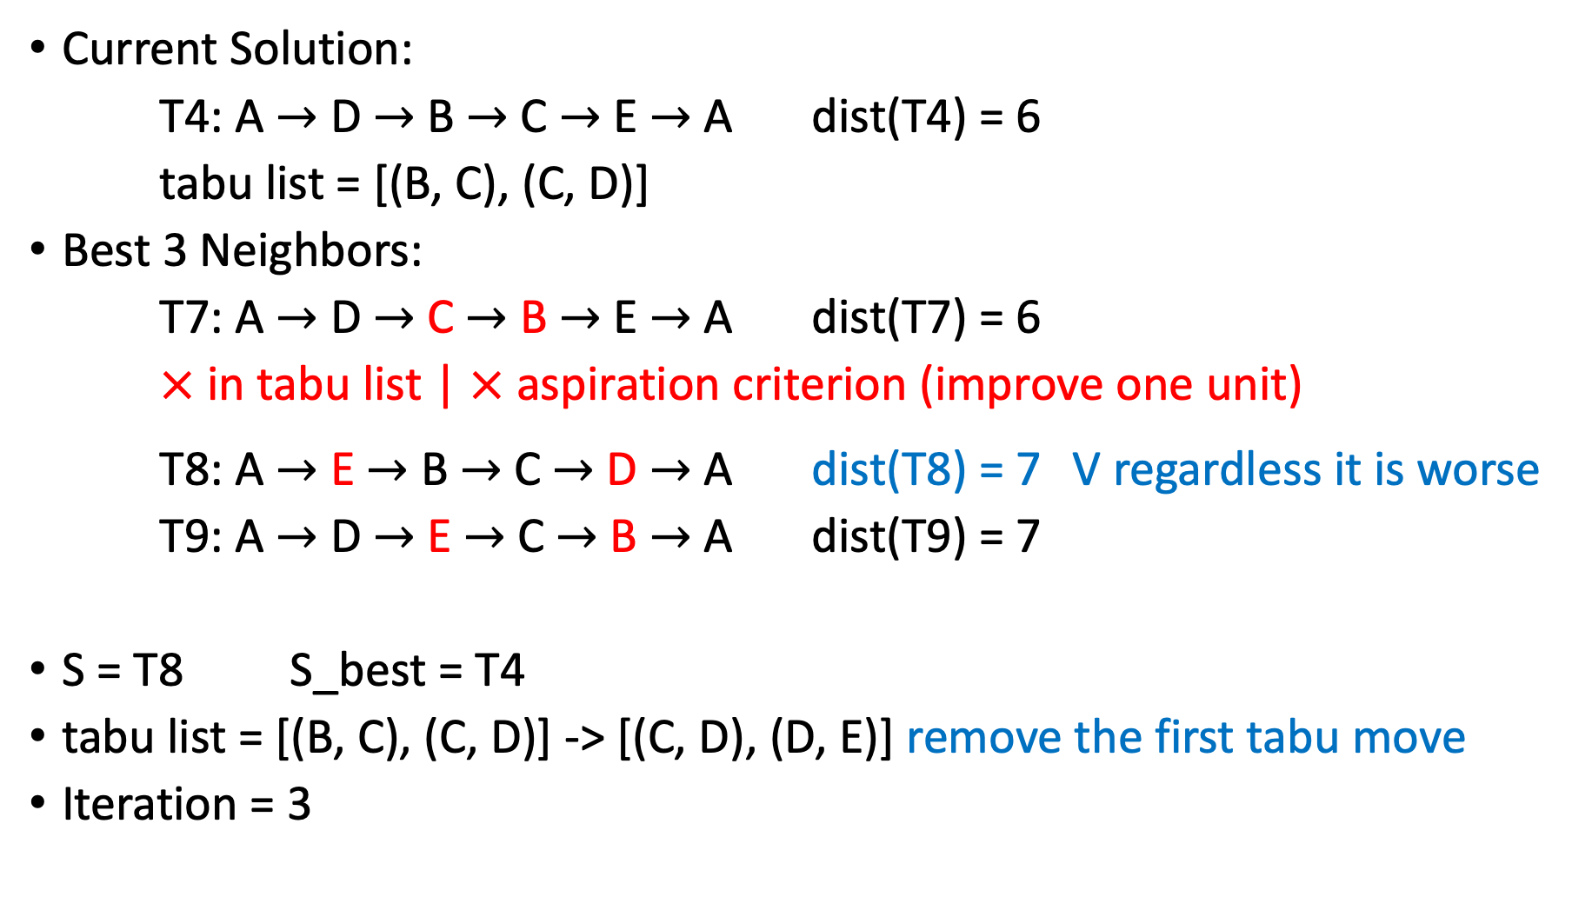
Current Solution:
T4: A $→$ D $→$ B $→$ C $→$ E $→$ A dist(T4) = 6
tabu list = [(B, C), (C, D)]
Best 3 Neighbors:
T7: A $→$ D $→$ C $→$ B $→$ E $→$ A dist(T7) = 6
$×$ in tabu list | $×$ aspiration criterion (improve one unit)
T8: A $→$ E $→$ B $→$ C $→$ D $→$ A dist(T8) = 7 V regardless it is worse
T9: A $→$ D $→$ E $→$ C $→$ B $→$ A dist(T9) = 7
S = T8 S_best = T4
tabu list = [(B, C), (C, D)] -> [(C, D), (D, E)] remove the first tabu move
Iteration = 3

Slide 14
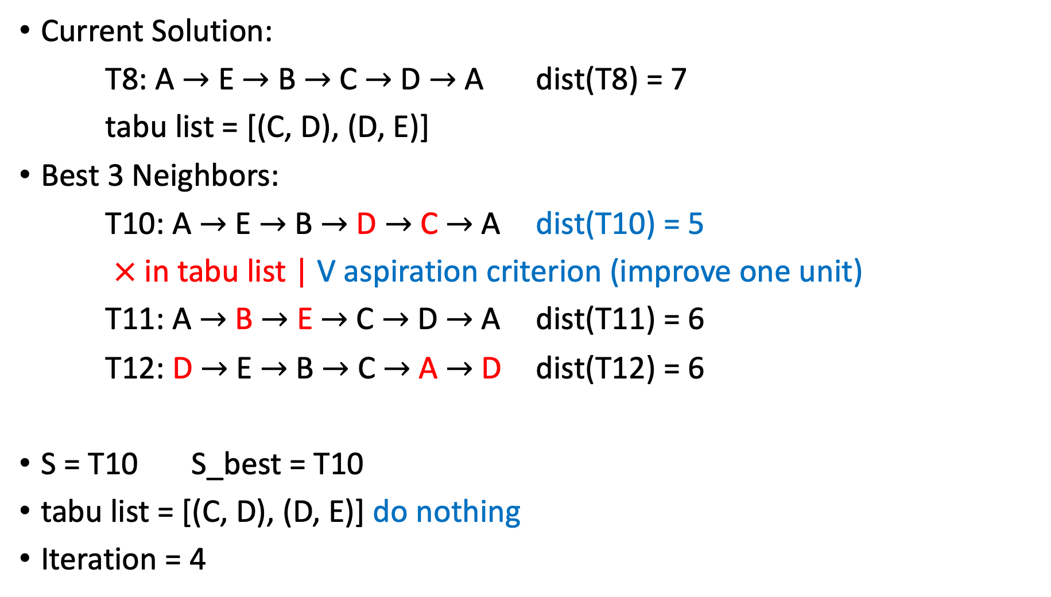
Current Solution:
T8: A $→$ E $→$ B $→$ C $→$ D $→$ A dist(T8) = 7
tabu list = [(C, D), (D, E)]
Best 3 Neighbors:
T10: A $→$ E $→$ B $→$ D $→$ C $→$ A dist(T10) = 5
$×$ in tabu list | V aspiration criterion (improve one unit)
T11: A $→$ B $→$ E $→$ C $→$ D $→$ A dist(T11) = 6
T12: D $→$ E $→$ B $→$ C $→$ A $→$ D dist(T12) = 6
S = T10 S_best = T10
tabu list = [(C, D), (D, E)] do nothing
Iteration = 4
Notes:
Question about aspiration criterion: We are now searching in different neighborhood

Slide 15
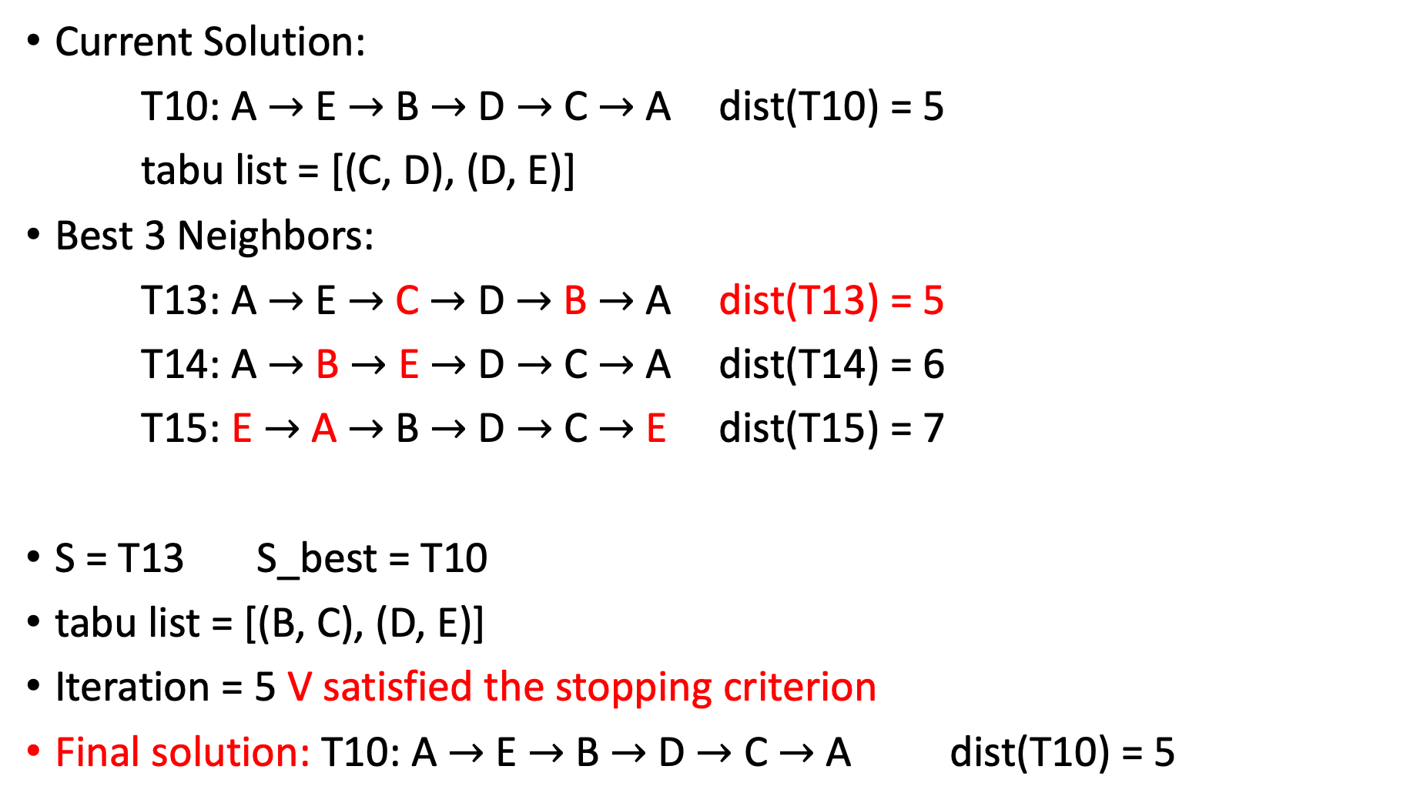
Current Solution:
T10: A $→$ E $→$ B $→$ D $→$ C $→$ A dist(T10) = 5
tabu list = [(C, D), (D, E)]
Best 3 Neighbors:
T13: A $→$ E $→$ C $→$ D $→$ B $→$ A dist(T13) = 5
T14: A $→$ B $→$ E $→$ D $→$ C $→$ A dist(T14) = 6
T15: E $→$ A $→$ B $→$ D $→$ C $→$ E dist(T15) = 7
S = T13 S_best = T10
tabu list = [(B, C), (D, E)]
Iteration = 5 V satisfied the stopping criterion
Final solution: T10: A $→$ E $→$ B $→$ D $→$ C $→$ A dist(T10) = 5

Slide 16
Portfolio Optimization

Slide 17
Portfolio
Objective: build a portfolio that maximize the historical return
Constraints:
Should at least select 10 to at most 30 stocks from the stock pool
The number of stocks from the same sector cannot exceed 6
The average correlation of selected stocks cannot exceed 0.5
Average VaR cannot be lower than -0.03
Individual stock VaR cannot be lower than -0.05
Notes:
There are several restrictions on constructing a portfolio
Value at risk: Value at risk (VaR) is a measure of the risk of loss for investments. It estimates how much a set of investments might lose (with a given probability), given normal market conditions, in a set time period such as a day. The smaller the VaR means the stocks is more risky

Slide 18
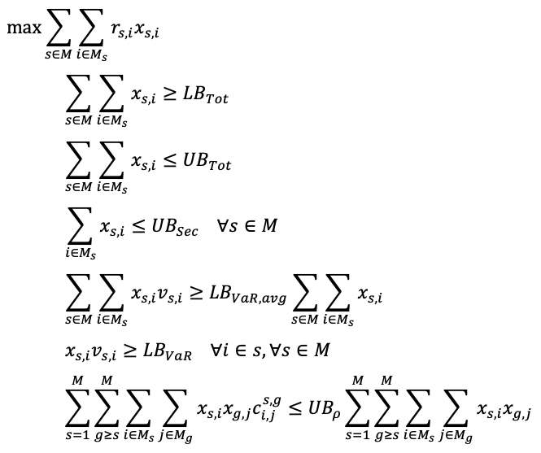
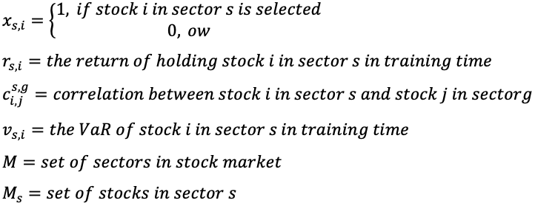
Integer Programming Formulation
Notes:
Each line of constraint represents each constraint in the previous slide

Slide 19
Dataset
Stock Pool: S&P 500 component stocks
Training period: 2016-01-01~2019-12-31
Testing period: 2020-01-01~2020-04-17
(the huge drop is on 2020-02-21)
has trend: 2020-01-01~2020-02-19
no trend: 2020-02-19~2020-04-17

Slide 20
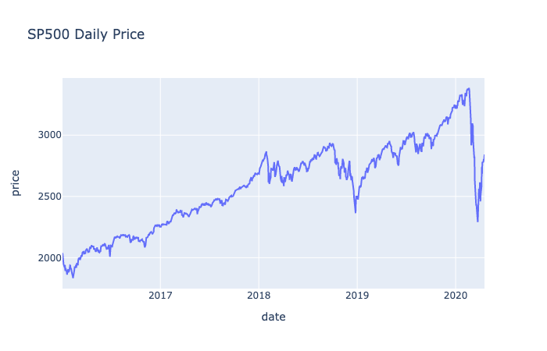

Slide 21
Modification
Neighborhood Set:
1. removing one stock from the portfolio
2. adding one stock to the portfolio
3. removing one stock and adding another one at the same time
neighbor_size
=> how many neighbors to sample from the neighborhood set

Slide 22
Experiment Results

Slide 23
Tabu search parameters:
{'tabu_list_size': 20, 'iterations_times': 1000, 'early_stop': 50,
'neighbor_size': 50, 'asp_improve_level': 1}

Slide 24
Tabu Search Parameters
Using grid search to find the appropriate parameters for this problem
Tabu list size | 10 | 30 | 50
Max iterations | 100 | 200 | 300
Early Stop | 20 | 50 | Inf
Aspiration Level | -1 | 1 | 5
Neighbor Size | 50 | 100 | 300
Training TS for 3**5 times

Slide 25
Gurobi: cannot find (global) optimal value after running almost 3 days
Notes:
Y axis means the return on test set
It seems that all tabu search converge to 3 solutions

Slide 26
 | count | mean | std | min | 25% | 50% | 75% | max | SP500
train_perf | 243.0 | 0.9290 | 0.0732 | 0.8432 | 0.8432 | 0.9222 | 1.0217 | 1.0217 | 0.5774
whole_period_perf | 243.0 | -0.1241 | 0.0146 | -0.1388 | -0.1388 | -0.1291 | -0.1042 | -0.1042 | -0.1239
normal_period_perf | 243.0 | 0.0415 | 0.0065 | 0.0323 | 0.0323 | 0.0459 | 0.0463 | 0.0463 | 0.0418
extreme_period_perf | 243.0 | -0.1588 | 0.0192 | -0.1769 | -0.1769 | -0.1674 | -0.1323 | -0.1323 | -0.1591
cand_test_perf | 243.0 | -0.0792 | 0.0145 | -0.0959 | -0.0959 | -0.0813 | -0.0605 | -0.0605
used_time | 243.0 | 169.7392 | 151.6012 | 30.3094 | 64.5552 | 112.8851 | 225.8990 | 818.1573
iteration | 243.0 | 113.8889 | 79.0177 | 43.0000 | 63.0000 | 90.0000 | 101.0000 | 301.0000

Slide 27
Conclusions
Tabu search is more practical on a complex optimization problem
Tabu search seems to converge to three portfolios in this problem
There is no significant difference in the result of different tabu parameters
There seems to have overfitting problem -> need to add some predicting information to evaluate stocks
Notes:
So what im thinking is to adding some predicting information to evaluate stocks to make the portfolio more robost in difficult time

Slide 28
Reference
Picture:
local and global optimum: https://www.researchgate.net/figure/Local-versus-global-optimum_fig1_228563694
Tabu search flow chart: https://www.researchgate.net/figure/Flowchart-of-tabu-search-algorithm_fig1_320508257
Paper:
Portfolio optimization models and a tabu search algorithm for the Kuwait Stock Exchange: https://www.researchgate.net/publication/286938758_Portfolio_optimization_models_and_a_tabu_search_algorithm_for_the_Kuwait_Stock_Exchange

